Slide 1



BANK LOAN ANALYSIS
Prithu Sharma
Imarticus Learning, Jaipur

Slide 2
PROBLEM STATEMENT
Our Bank lacks a centralized loan monitoring system for lending activities which is hinders evaluation of loan metrics and trends. This makes it harder to understand risk and opportunities affecting how we manage loans and make money.
Current Situation
Profitability Analysis by analyzing data related to interest income and loan quality.
Develop a comprehensive reporting system that highlights key loan related metrics and trends.
Enabling data driven decision making like loan approvals, risk assessment.
Problem Scope
Identify Key Performance Indicators based on our problem statement.
Write SQL queries highlighting the KPIs and answering various other business problems.
Develop a fully interactive dashboard showcasing the KPIs, Monthly loan trends, Regional analysis, loan term and purpose analysis, etc.
Key Objectives
Technologies Used: Excel, MySQL, Tableau

Slide 3
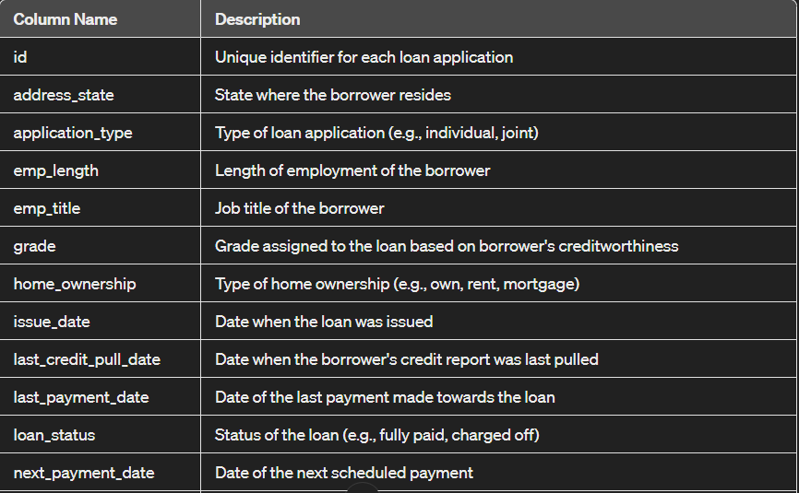
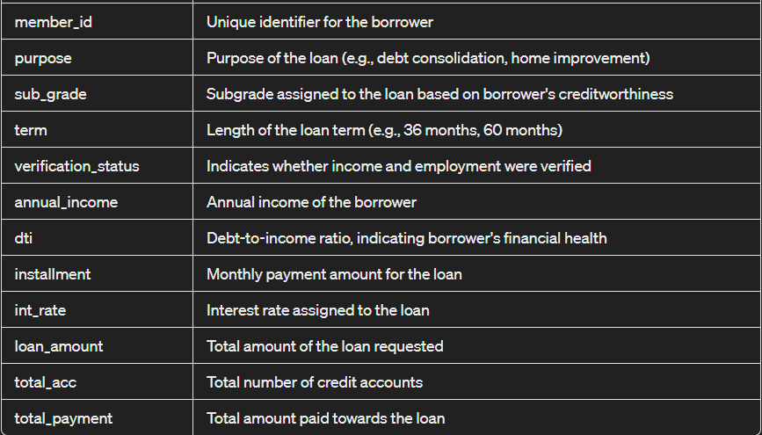
ABOUT THE DATASET
This Dataset contains loan information spanning over the entire year 2021. We have 38576 rows and 24 columns.

Slide 4

KEY PERFROMANCE INDICATORS
Total Loan Applications: We need to calculate the total number of loan applications received during a specified period. Additionally, it is essential to monitor the Month-to-Date (MTD) Loan Applications and track changes Month-over-Month (MoM).
Total Funded Amount: Understanding the total amount of funds disbursed as loans is crucial. We also want to keep an eye on the MTD Total Funded Amount and analyze the Month-over-Month (MoM) changes in this metric.
Total Amount Received: Tracking the total amount received from borrowers is essential for assessing the bank's cash flow and loan repayment. We should analyze the Month-to-Date (MTD) Total Amount Received and observe the Month-over-Month (MoM) changes.
Average Interest Rate: Calculating the average interest rate across all loans, MTD, and monitoring the Month-over-Month (MoM) variations in interest rates will provide insights into our lending portfolio's overall cost.
Average Debt-to-Income Ratio (DTI): Evaluating the average DTI for our borrowers helps us gauge their financial health. We need to compute the average DTI for all loans, MTD, and track Month-over-Month (MoM) fluctuations.

Slide 5
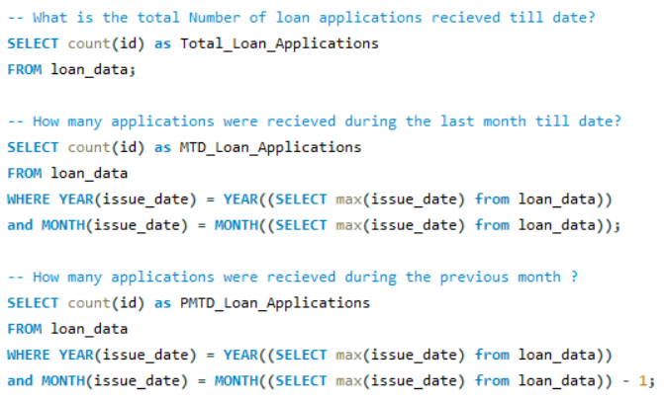
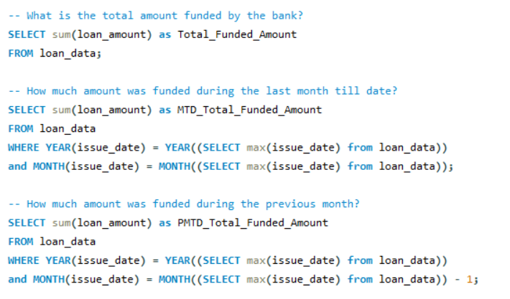
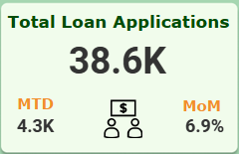
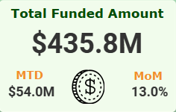
GENERATING & DESIGNING KPIs
1. Total Loan Applications:
2. Total Funded Amount

Slide 6
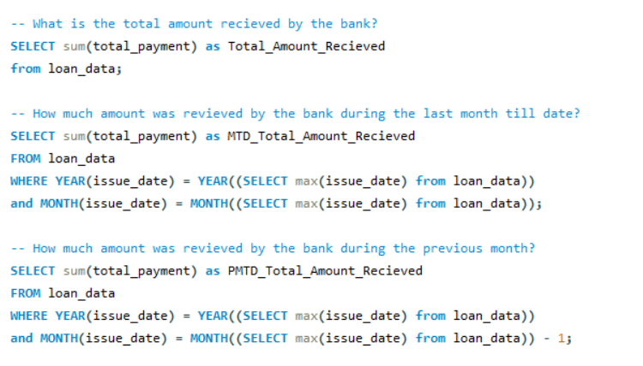
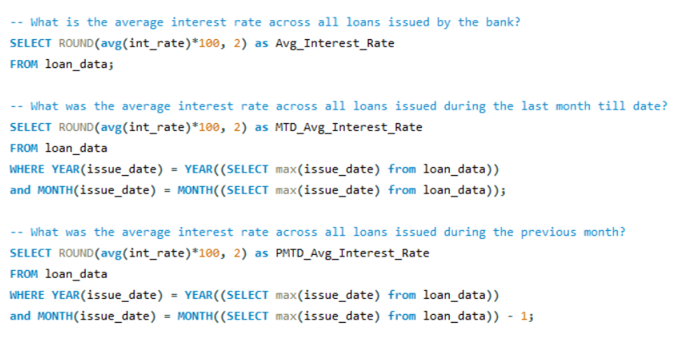
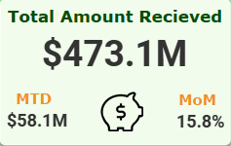
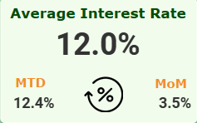
GENERATING & DESIGNING KPIs
3. Total Amount Received:
4. Average Interest Rate

Slide 7
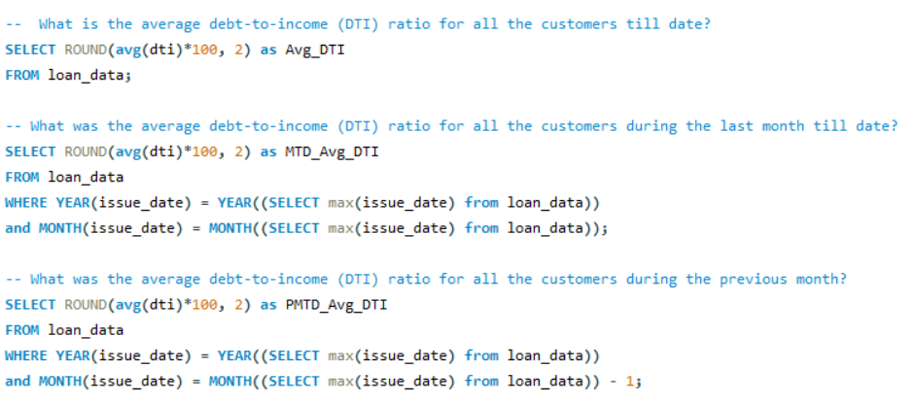
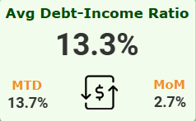
GENERATING & DESIGNING KPIs
5. Average Debt to Income Ratio:

Slide 8
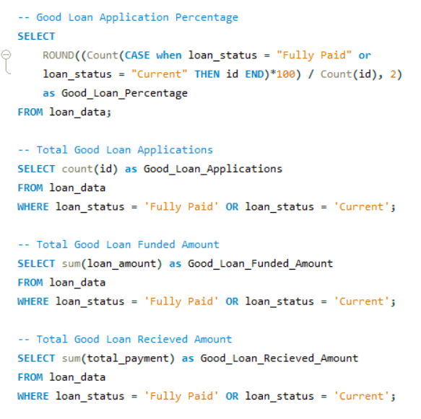
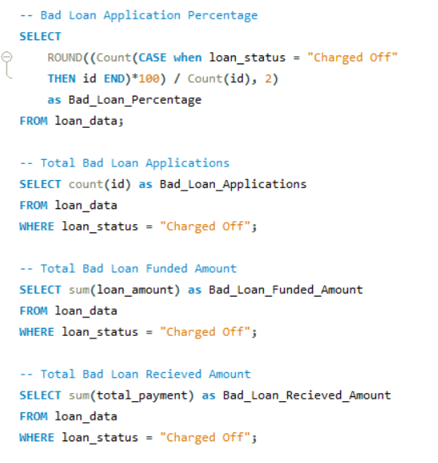
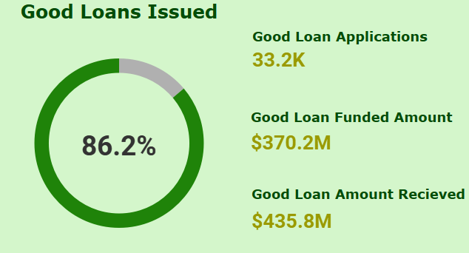
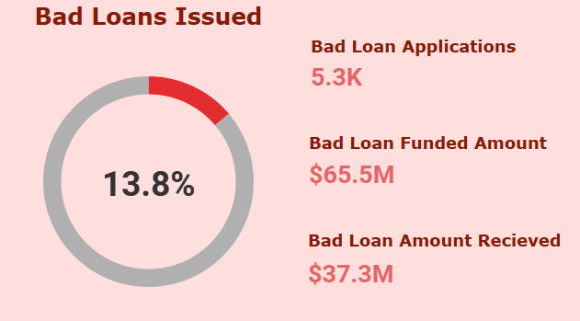
GOOD LOANS VS BAD LOANS
GOOD LOANS:
BAD LOANS:

Slide 9
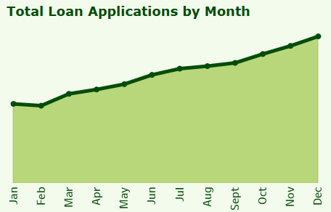
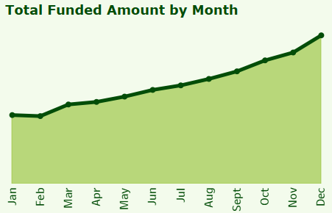
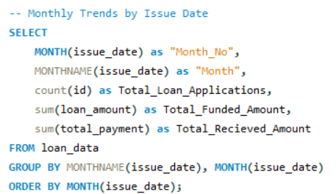
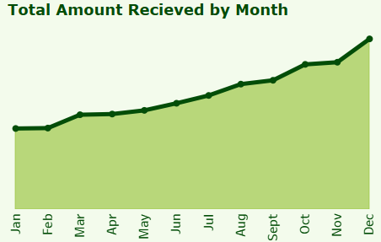
MONTHLY LOAN TREND BY ISSUE DATE
Overall Monthly Trend over the entire year has been positive.
Total Loan Applications have increased month by month and so has the funded amount.
Total amount received back by the bank stalled a bit in the periods of (Jan-Feb), (March-Apr) and (Oct-Nov).

Slide 10
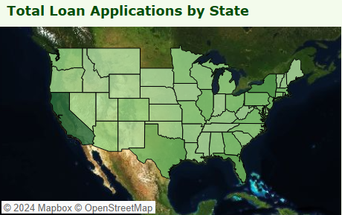
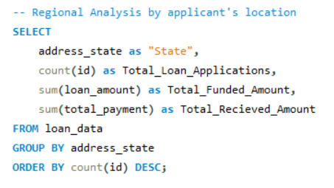
REGIONAL LOAN ANALYSIS BY STATE
The dataset contains information about the bank which has its branches all over USA.
Most amount of loan applications were from the state of California. It is also the leader in Total Funded amount and Total amount received.
Least loan applications were from Maine, so was the total loan amount funded and total amount received.

Slide 11
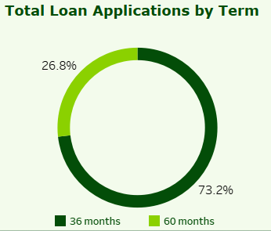
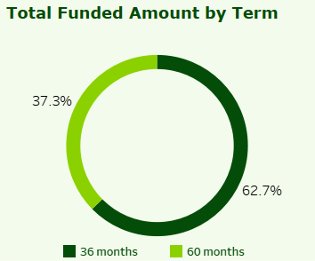
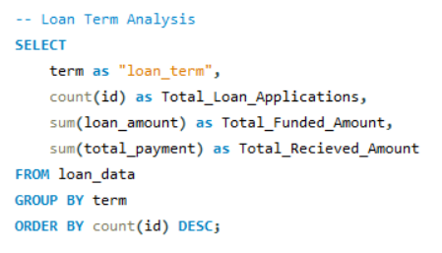
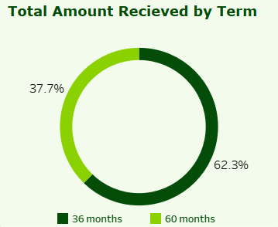
LOAN TERM ANALYSIS
Majority of the offered loans are short term loans (36 months)
The Lion’s share of total funded amount and total received amount is also from the short term loans (36 months)

Slide 12
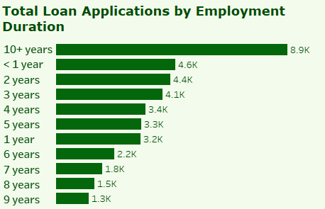
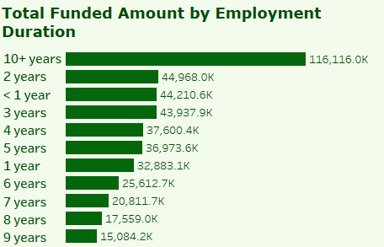
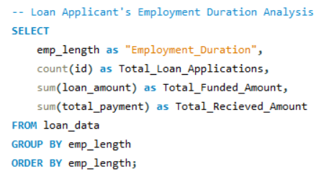
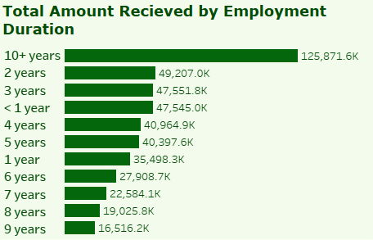
EMPLOYMENT DURATION ANALYSIS
Majority of the Loan applications were filed by people employed over 10 years. This might be due to the fact that these people are financially more stable and have more ambitious life goals (e.g. Weddings, medical expenses, etc.)
People with less than 1 or 2 years of professional experience might have settle previous debts such as education loans, so they are second in terms of loan applications and funded amounts

Slide 13
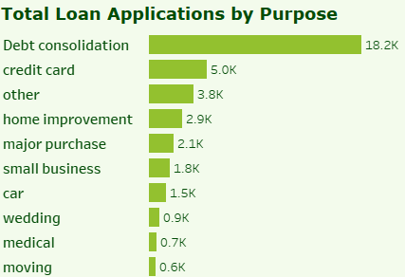
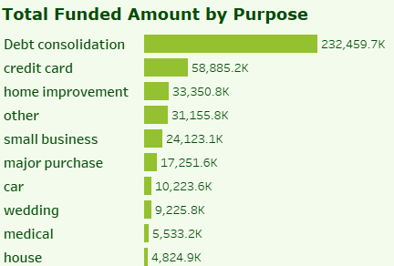
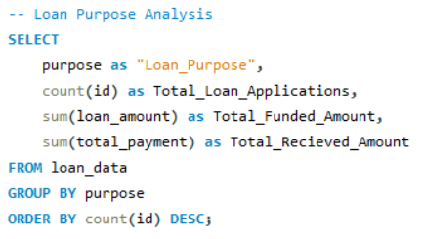
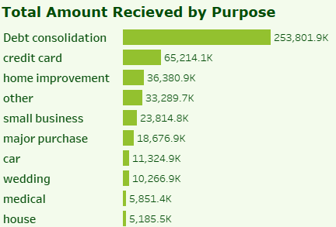
LOAN PURPOSE ANALYSIS
Majority of the loans are taken for the purpose of Debt Consolidation. Debt consolidation is combining all the debts into one big loan, so that you only have to make a single monthly payment, often with a lower interest rate. It makes loans easier to manage and potentially saves money in the long run.
Other major loan purposes involve credit card repayments and home improvement.

Slide 14
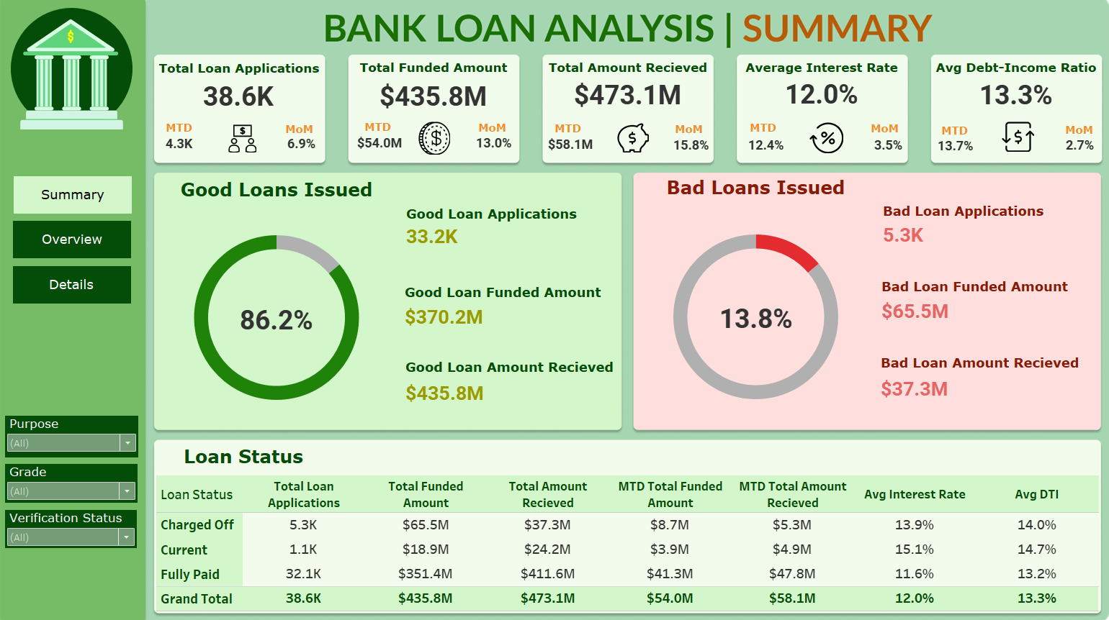
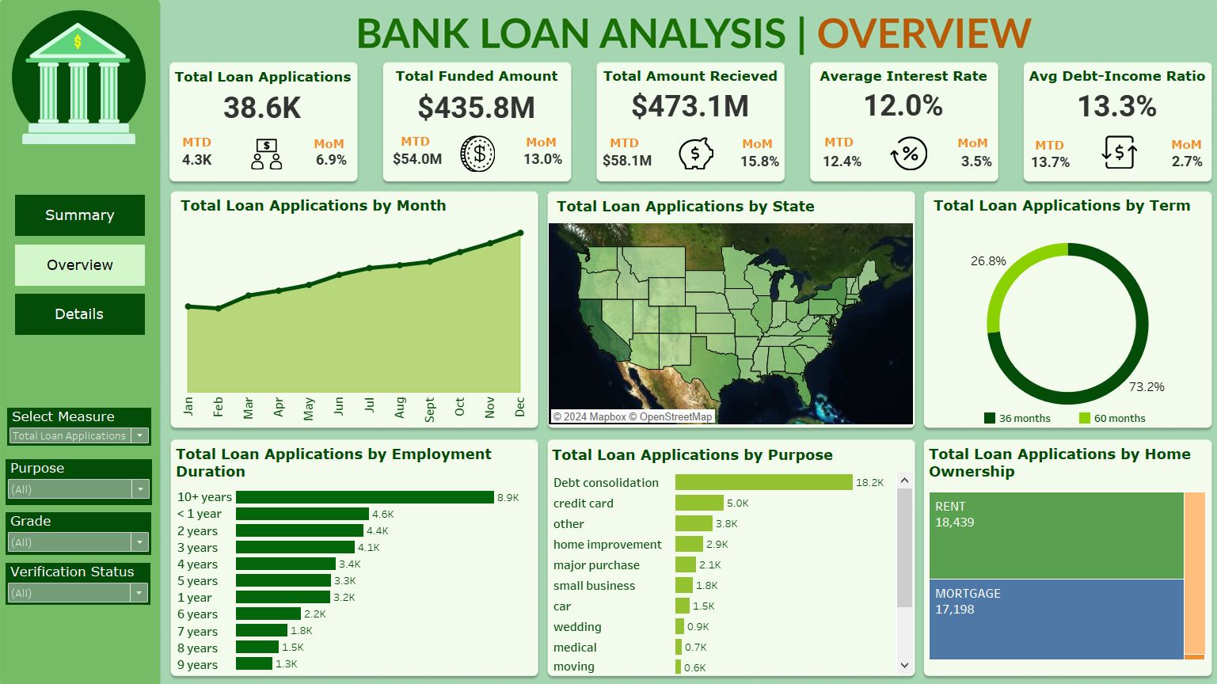
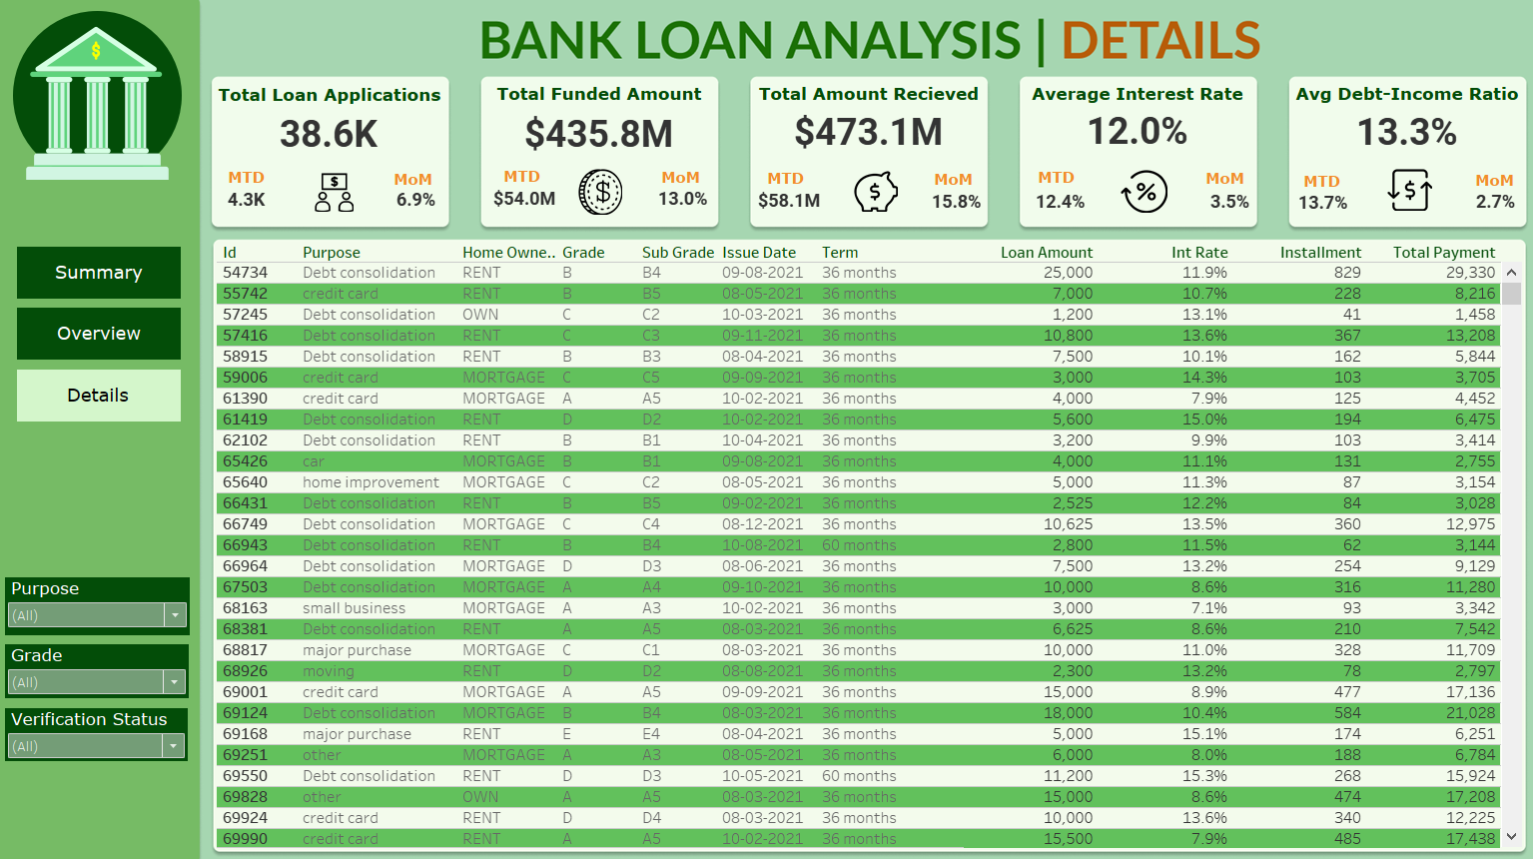
DASHBOARD SNAPSHOTS

Slide 15

KEY BUSINESS USE-CASES
RISK MANAGEMENT: Differentiating between Good Loans and Bad Loans based on a specific loan criteria helps identify potential credit risks and implement appropriate risk mitigation strategies.
LOAN PORTFOLIO HEALTH ASSESSMENT: Tracking key metrics such as Total Loan Applications, Total Funded Amount and Total Amount Received allows the banks to identify any significant discrepancies or trends that may indicate potential risks or opportunities for improvement.
REGIONAL EXPANSION: By performing in-depth loan analysis by state, banks can identify regions with high loan demand and low market penetration for potential branch expansion or targeted marketing efforts.
IMPROVE REPAYMENT RATES: Analyze Bad Loan metrics and borrower profiles (such as average DTI) to identify risk factors. Implement early intervention strategies to prevent defaults such as personalized guidance or loan restructuring options.
TARGET HIGH PERFORMING LOAN APPLICANTS: Utilizing DTI and Good Loan data to develop targeted marketing campaigns attracting borrowers with strong financial health.

Slide 16



THANK YOU

